Slide 1
Modern SharePoint Development with React.js
Notes:
This module introduces students to React.js and examines how React.js uses a component-based architecture and a virtual DOM to optimize performance. Students will learn to create and configure new Node.js projects as a Single Page Application (SPA) using React.js together with TypeScript and Webpack. The module walks through how to design an SPA by creating a hierarchy of React components which define properties, state and event handlers. The module introduces JSX and teaches students the essential concepts and syntax for writing TypeScript code in a TSX file to generate the HTML for a React component. Along the way, students will learn how to integrate the React Router into an SPA project to provide navigation across multiple views.

Slide 2
GitHub Repo

Slide 3
Agenda
Developing with Node.js, TypeScript and Webpack
Learning React.js Fundamentals
Using the Office UI Fabric React Component Library
Developing React Webparts with SharePoint Framework
Calling the Microsoft Graph API from React Webparts

Slide 4
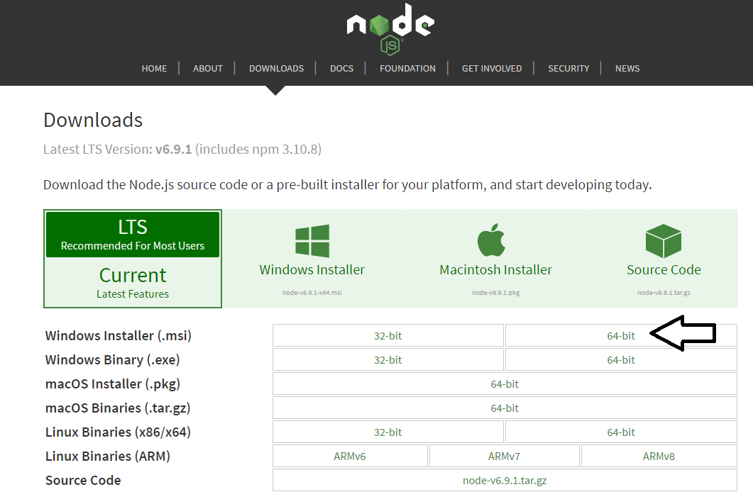
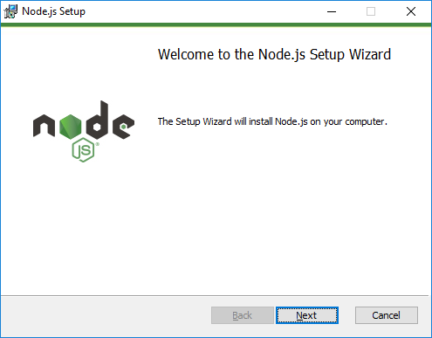
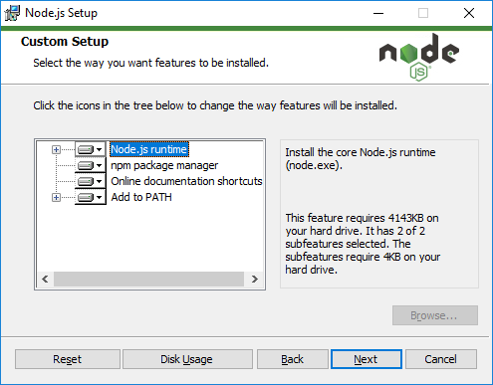
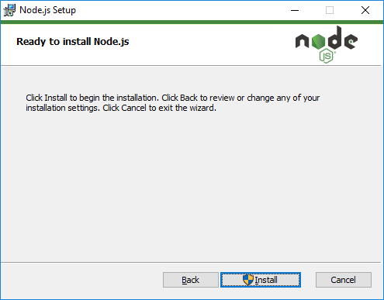
Installing node.js
https://nodejs.org/en/download/

Slide 5
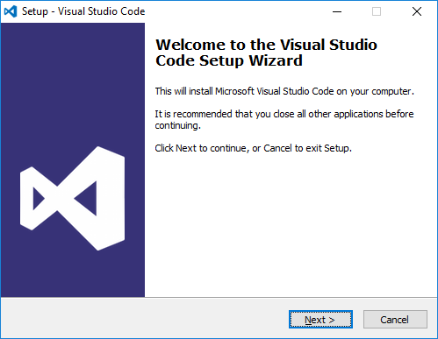
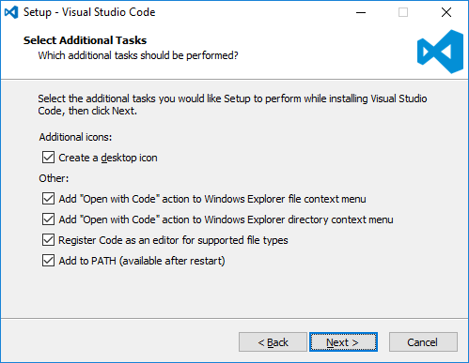
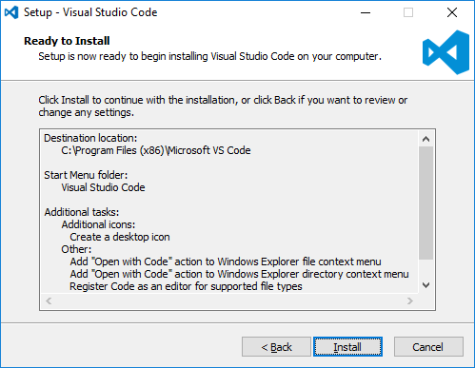
Install Visual Studio Code
http://code.visualstudio.com/

Slide 6
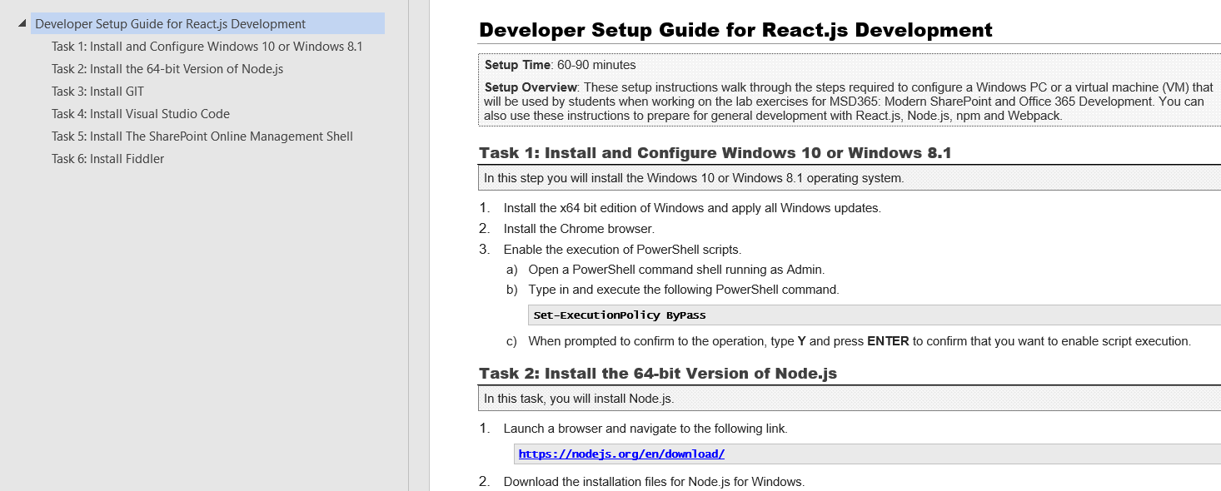
Modern React Developer Setup Guide

Slide 7
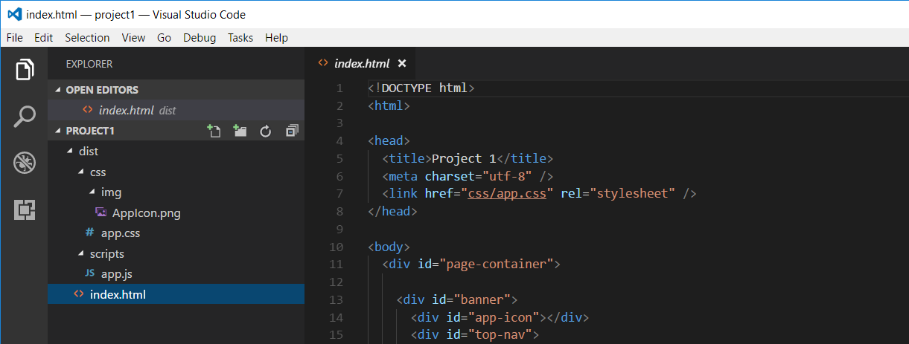
Developing with Visual Studio Code
Node.js is agnostic when it comes to developer IDE
There are many different IDEs that people use with Node.js
This course will be using Visual Studio Code
Visual Studio is not a good fit for Node.js development
Visual Studio solution & project files incompatible with Node.js

Slide 8
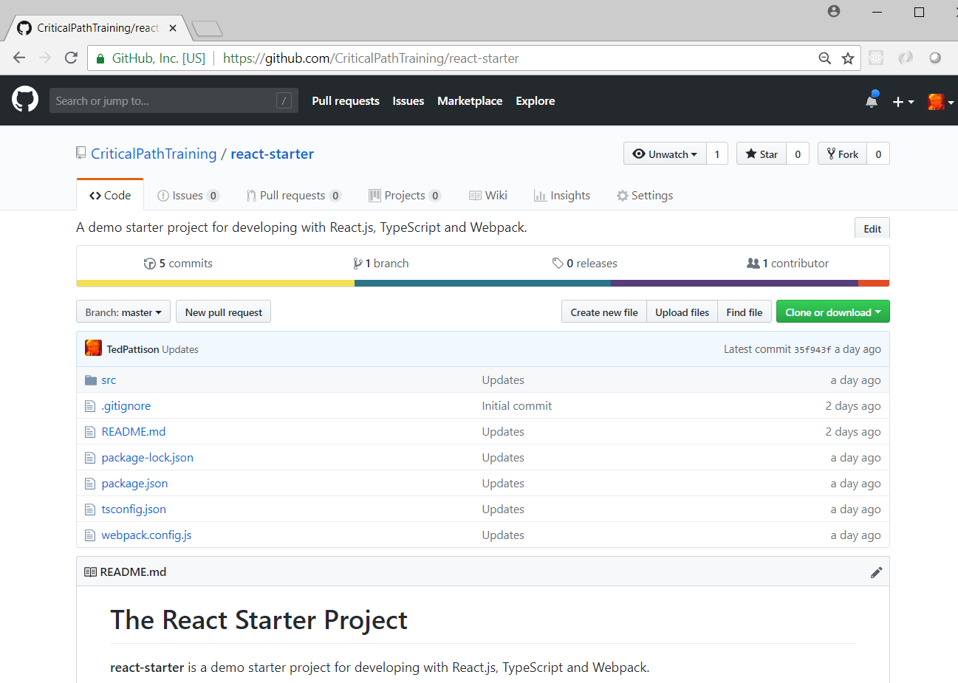
The React Starter Project
https://github.com/CriticalPathTraining/react-starter

Slide 9
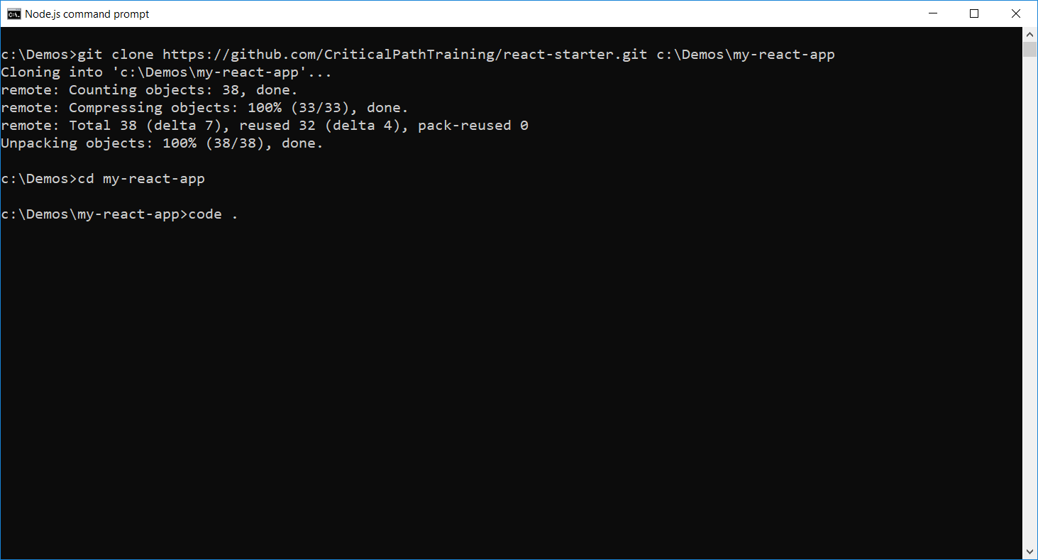
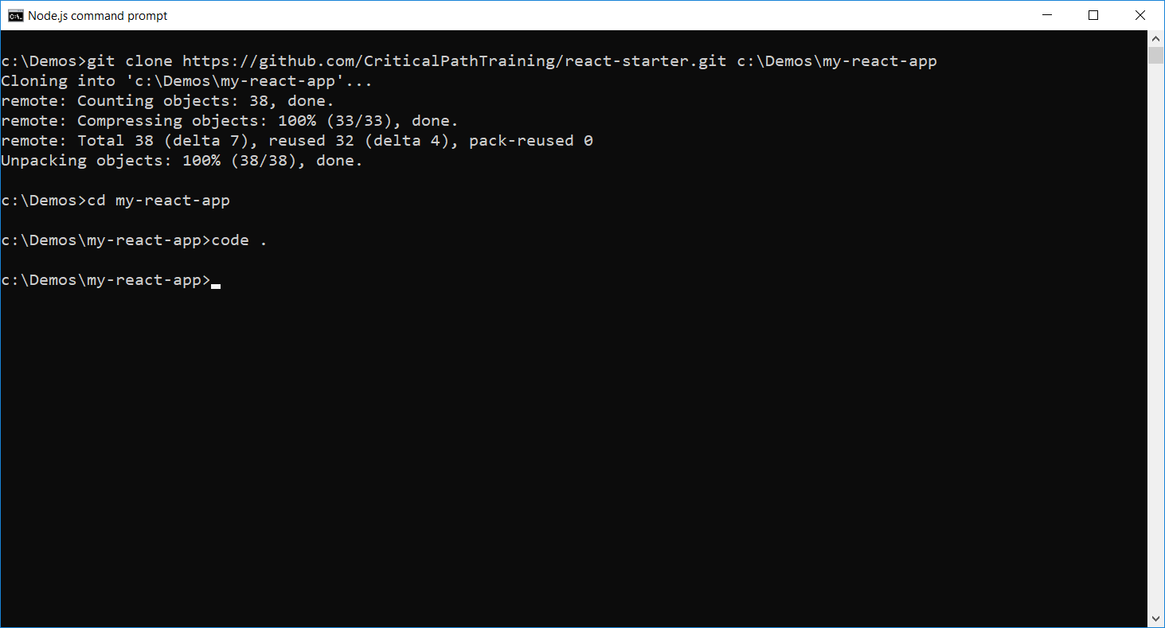
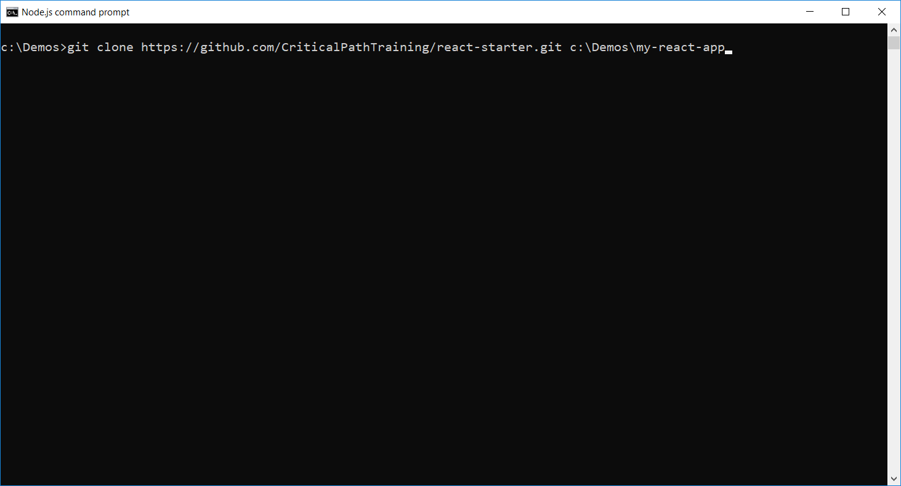
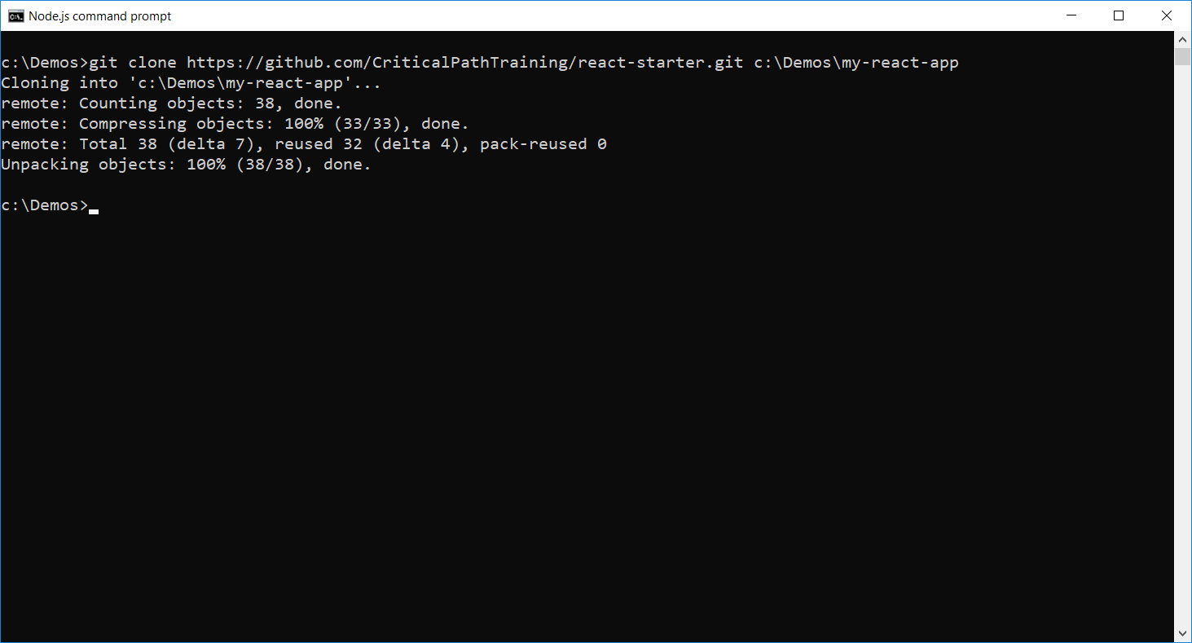
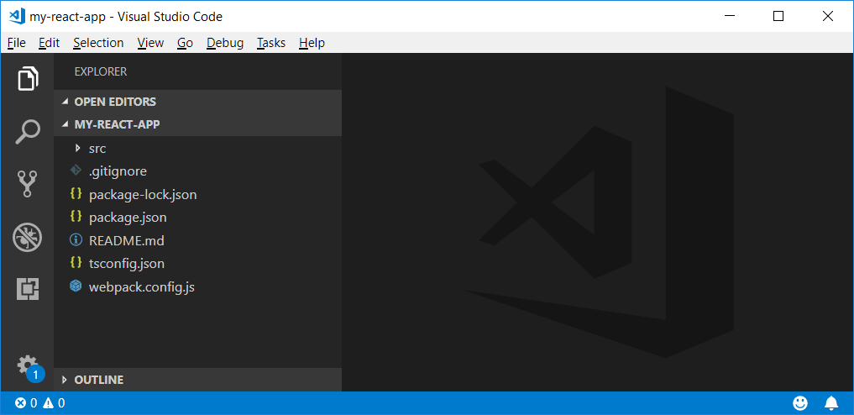
Cloning the Starter Project

Slide 10
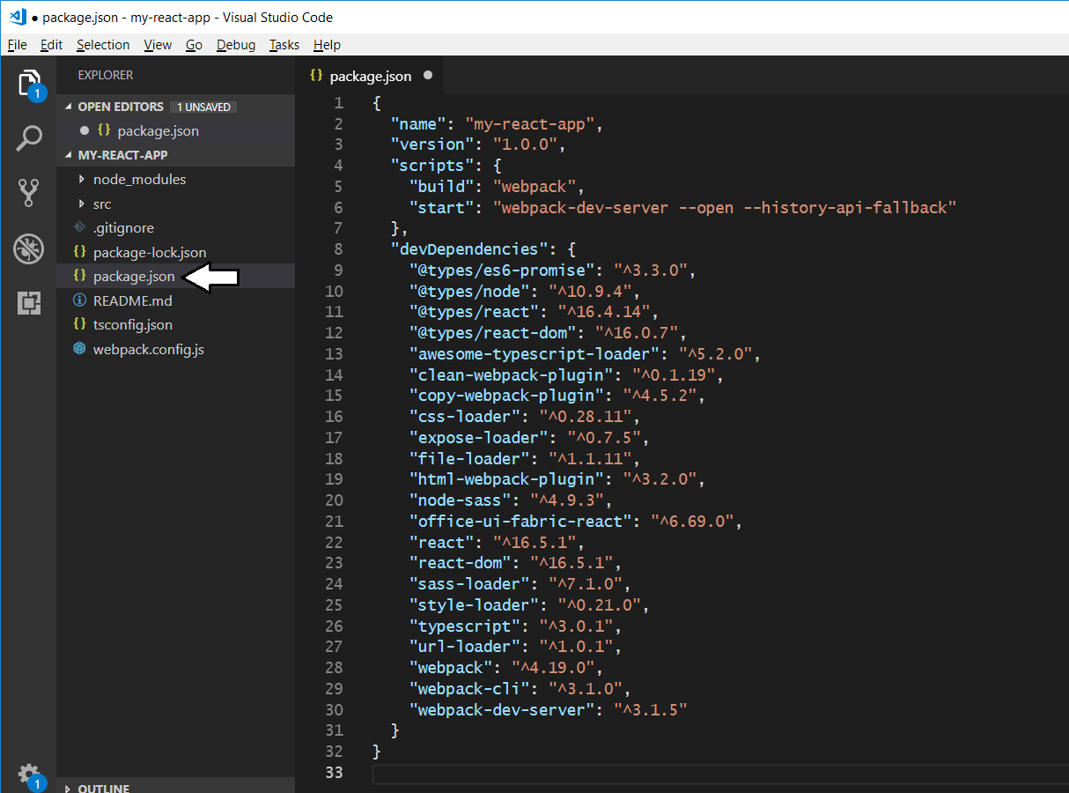
Starter Project - package.json
Rename the project

Slide 11
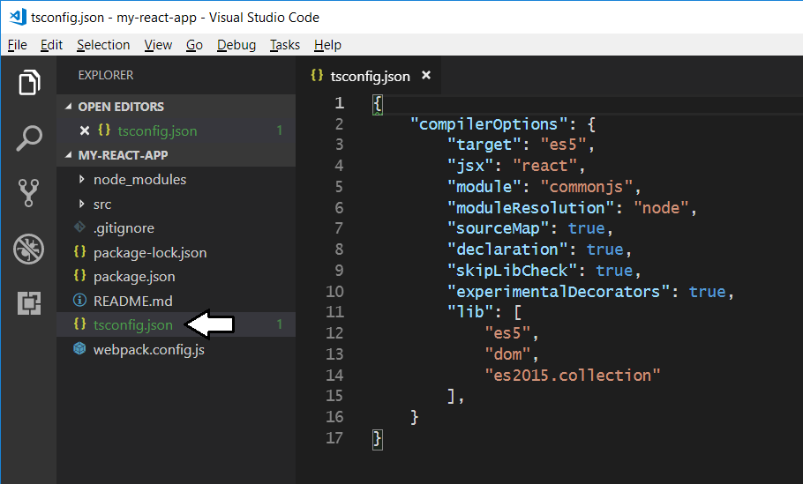
Starter Project tsconfig.json
Dynamic module loading

Slide 12
WebPack
WebPack serves as a bundling utility
Bundles many js/ts files into a single file
Can handle dynamic module loading
Provides a dev server for testing and debugging
When using Webpack 4
Install packages for webpack and webpack-cli
npm install webpack webpack-cli --save-dev

Slide 13
Webpack Dev Server
Webpack provides its own development server
Install the webpack dev server package
npm install webpack-dev-server --save-dev
Run your project using the webpack dev server CLI
webpack-dev-server --open

Slide 14
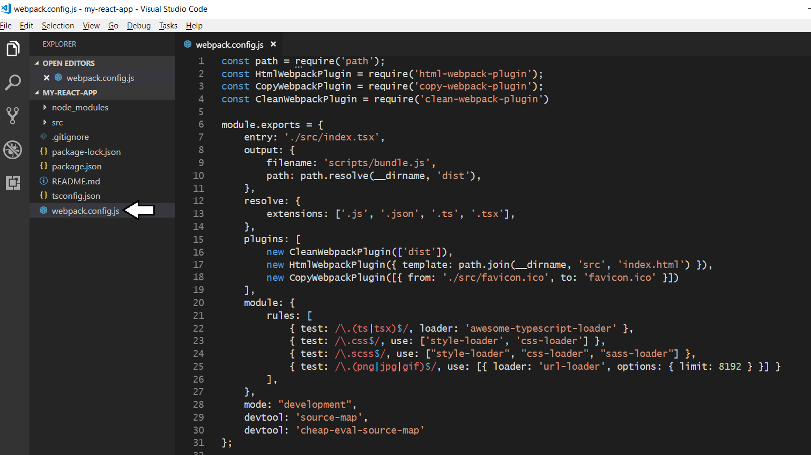
Starter Project - webpack.config.js

Slide 15
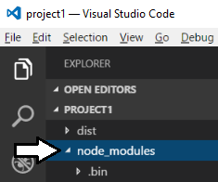
node_modules folder
Package files copied into node_modules folder
This folder often contain 100s of packages for a project
Contents of folder not saved into source control
Contents can be restored with npm install command

Slide 16
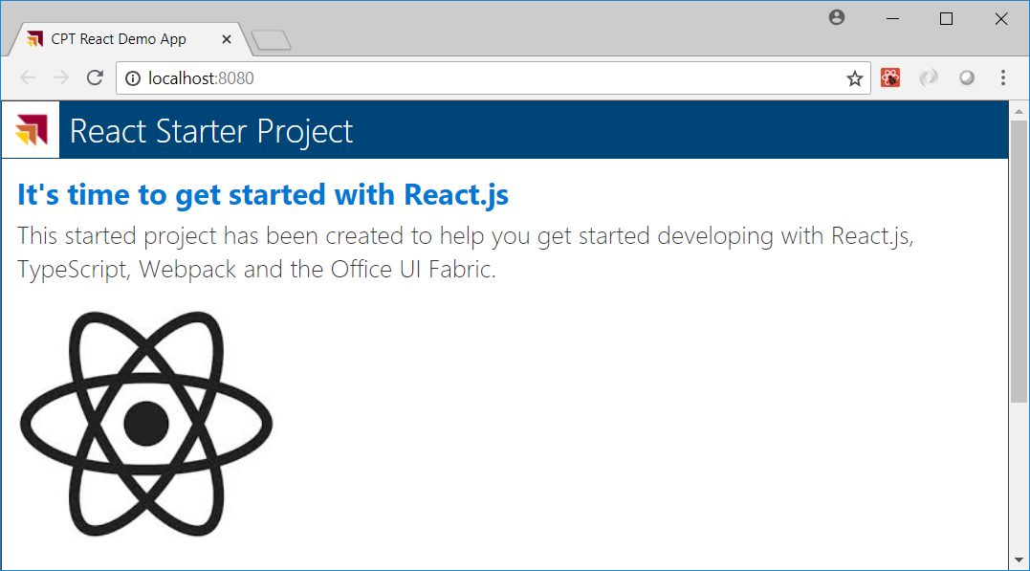
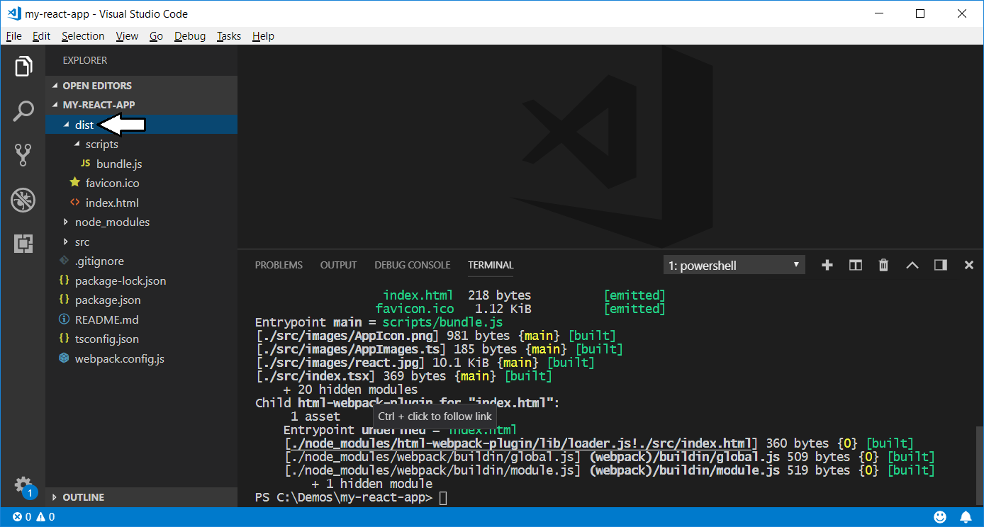
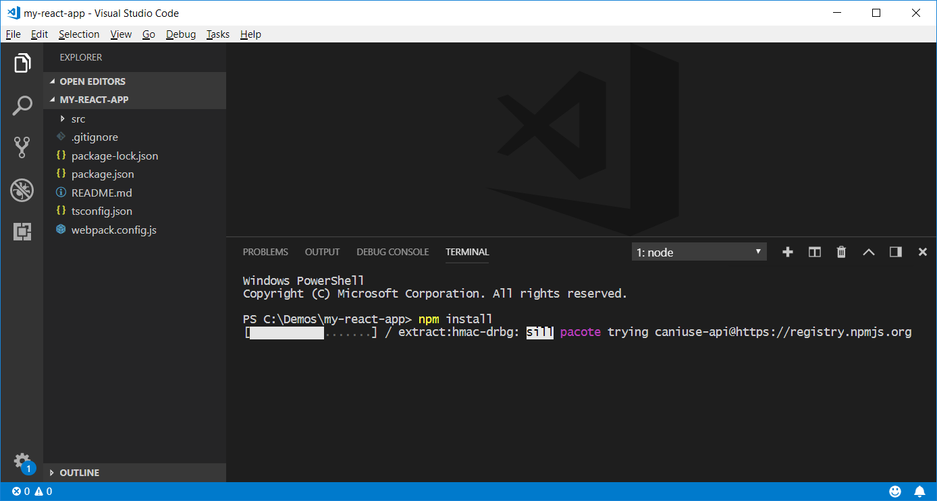
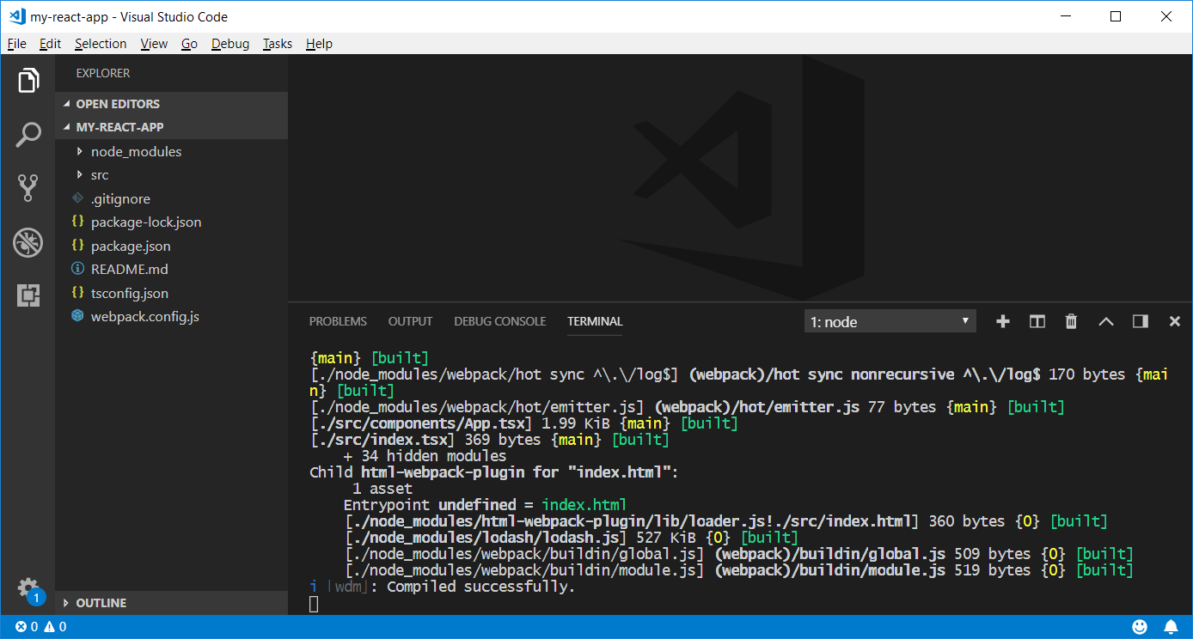
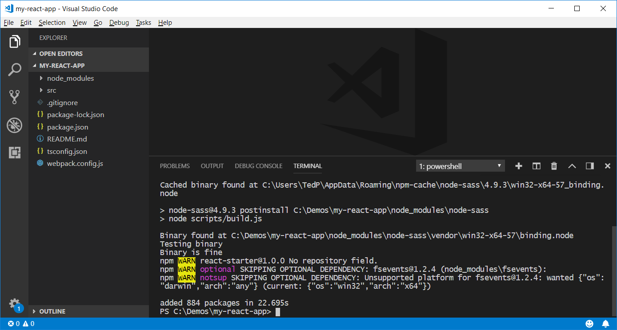
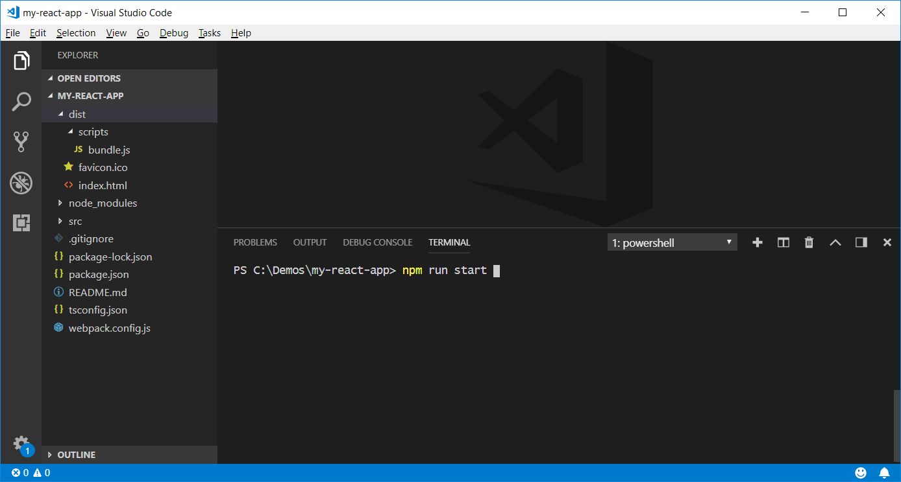
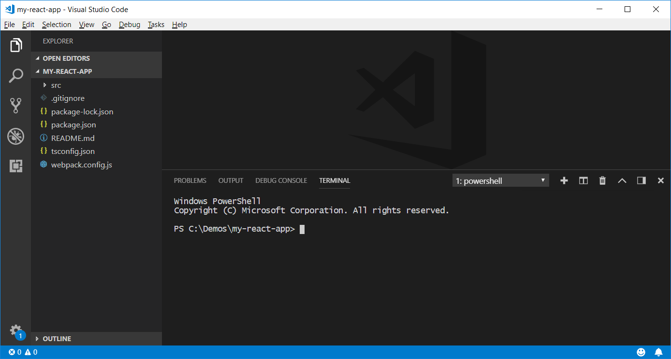
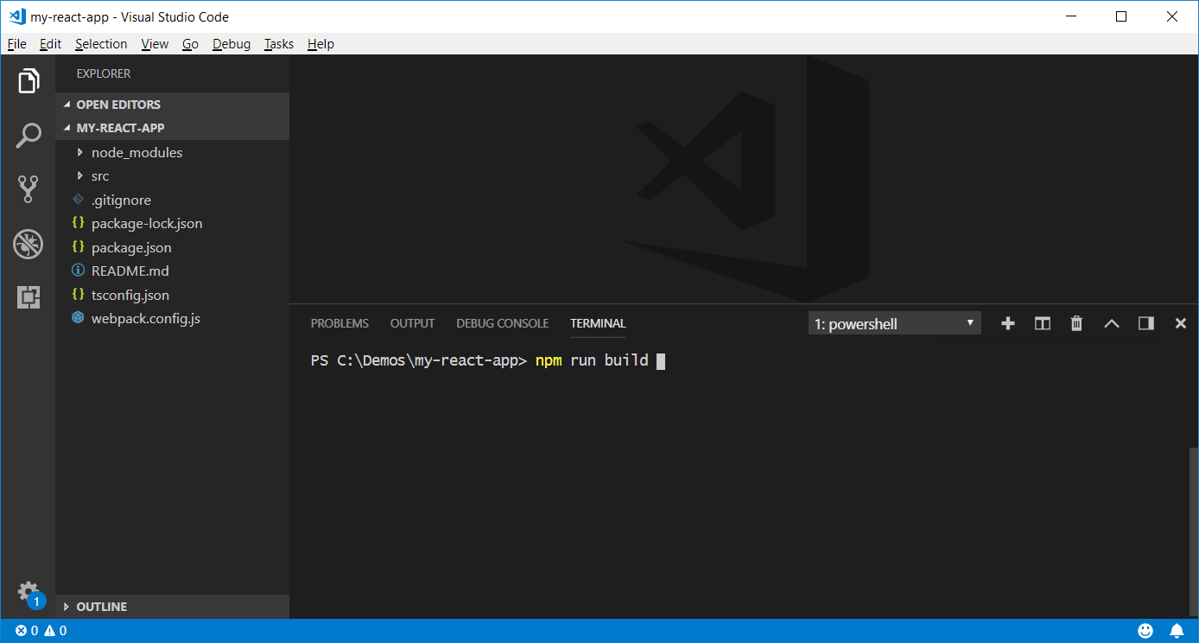
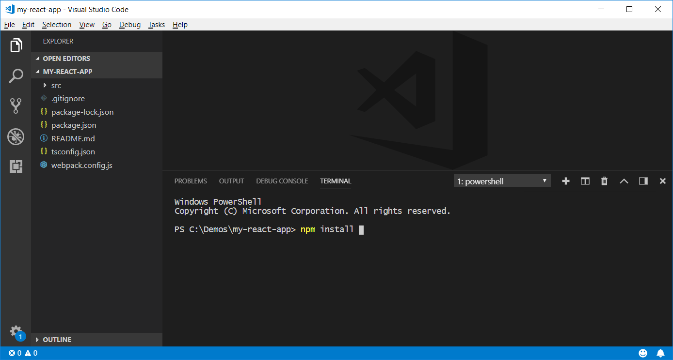
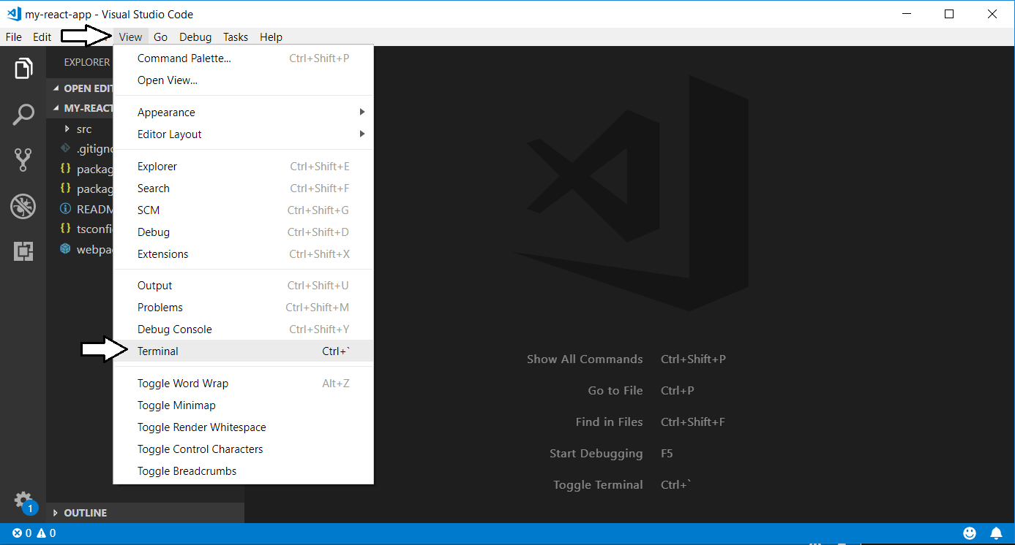
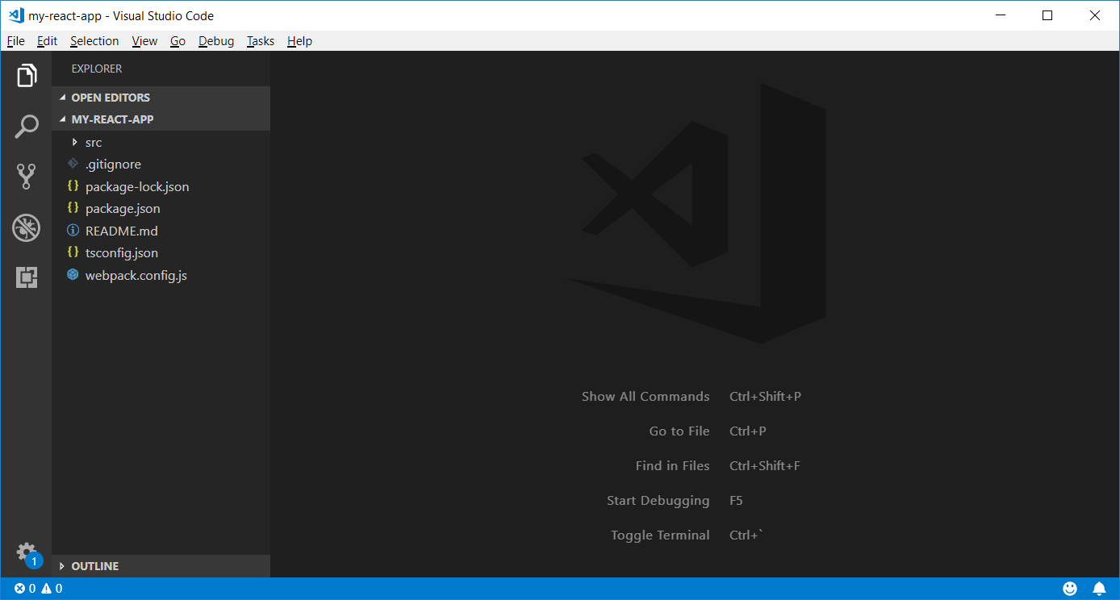
Executing npm Commands in Visual Studio Code

Slide 17
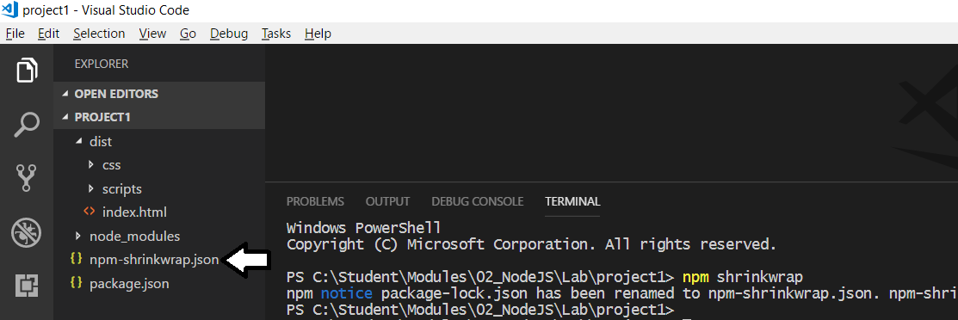
package.lock.json vs npm.shrinkwrap.json
npm generates files to track changes to node-modules
package.lock.json file initially created when installing packages.
package.lock.json file should not be checked into source control
Running npm shrinkwrap generates npm.shrinkwrap.json
npm.shrinkwrap.json file can be checked into source control

Slide 18
Project Install vs Global Install
Project installation adds package into project folder
Packages installed without -g parameter
npm install [package_name] --save-dev
npx command used to run CLIs from local node_modules folder
npx package_cli
Global installation adds into shared package cache
Packages installed with -g parameter
npm install -g [package_name]
Package CLIs can be called directly from command line
package_cli

Slide 19
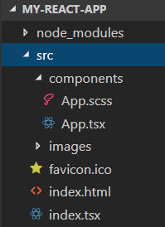
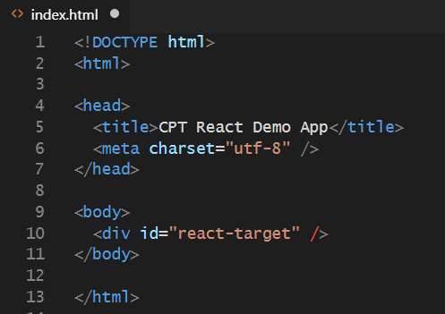
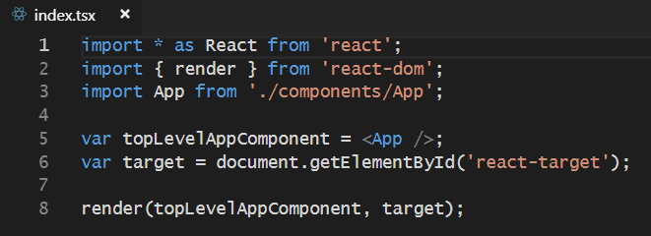
Starter Project Structure

Slide 20
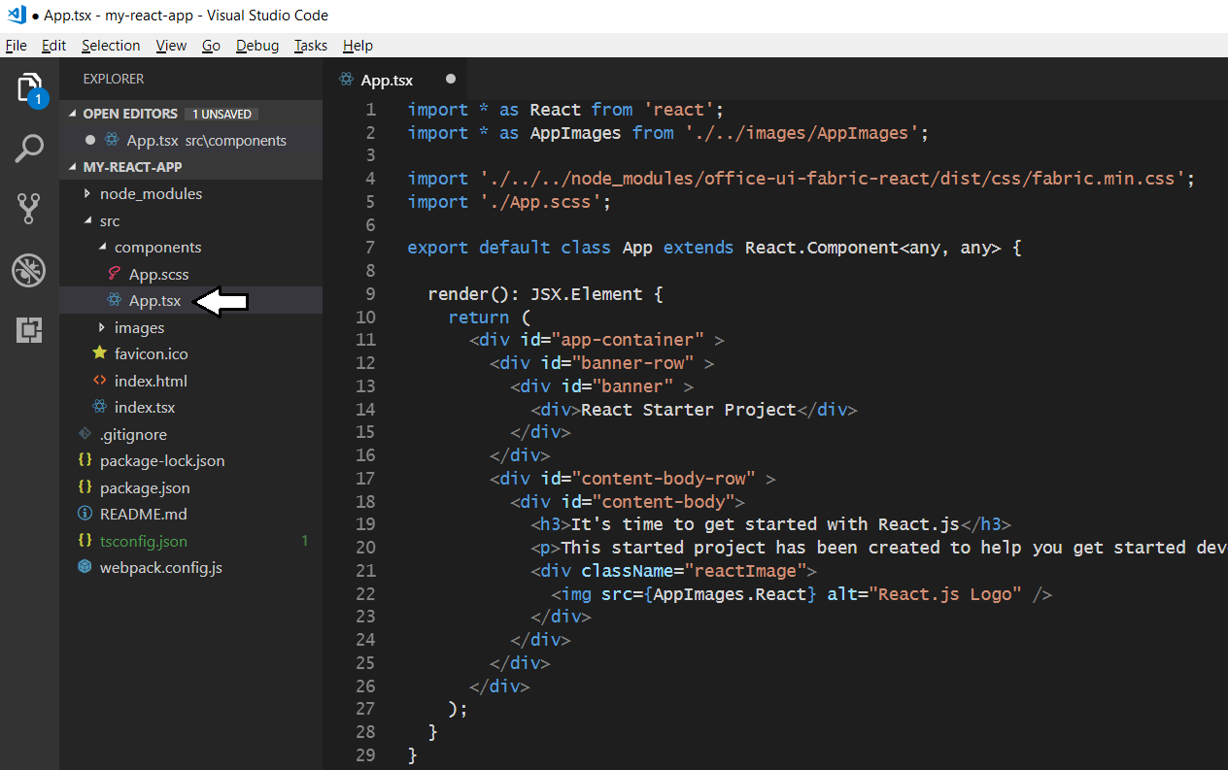
The Top-level App Component

Slide 21
Agenda
Developing with Node.js, TypeScript and Webpack
Learning React.js Fundamentals
Using the Office UI Fabric React Component Library
Developing React Webparts with SharePoint Framework
Calling the Microsoft Graph API from React Webparts

Slide 22
Introducing React
React is a library for building UI experiences
Not as all-encompassing as a framework like Angular
Focused on building HTML-based user experiences
Based on reusable component-based architecture
Components react to state changes by updating UI
React uses shadow DOM for efficient event handling
React was originally designed for Facebook
Also a good fit for building SPFx web parts

Slide 23
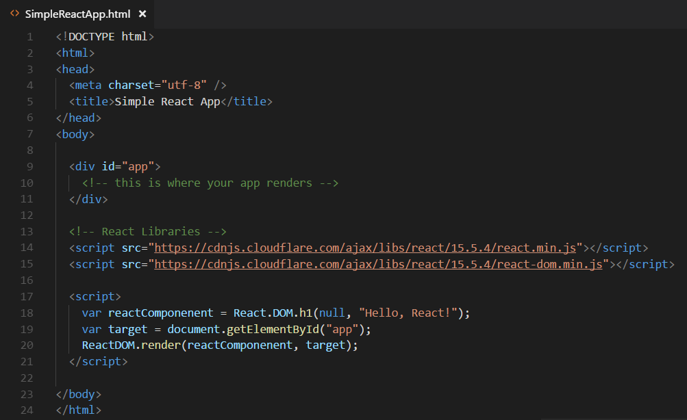
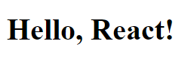
Hello World with React.js and JavaScript
Obtain the React library with npm or from a CDN
npm install react --save
npm install react-dom --save

Slide 24
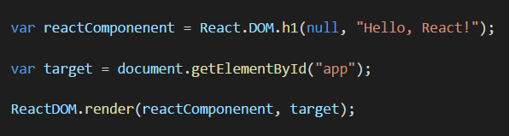
React versus ReactDOM
React and ReactDOM are separate libraries
React (react.js) is the primary library used to build out user experiences
ReactDOM (react-dom.js) is used to render React user experience in the browser
React library exposes global React object
React object is the main entry point into React API
React.DOM wraps standard HTML elements
ReactDOM library exposes global ReactDOM object
ReactDOM object used to render React components on web page

Slide 25
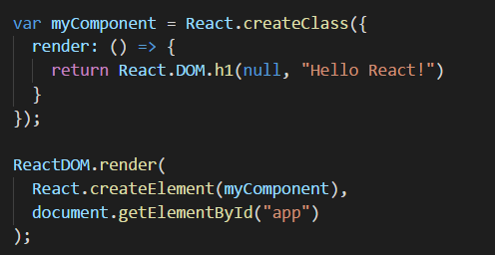
React Component Created Using ES5
React component can be created using EcmaScript 5
React component definition created using React.createClass
React component must be defined with render method
React component can be instantiated with React.createElement

Slide 26
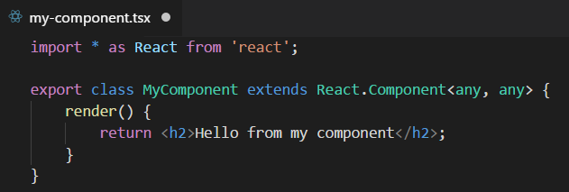
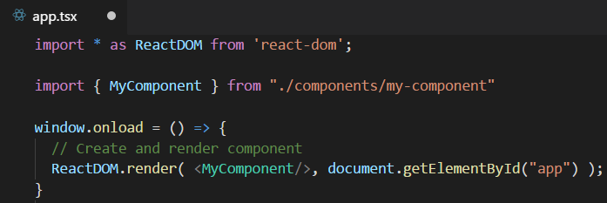
Defining React Components using TypeScript
Component is class extending React.Component
Component usually defined in its own tsx file
Component class must define render method
Component can be instantiated with JSX/TSX syntax

Slide 27
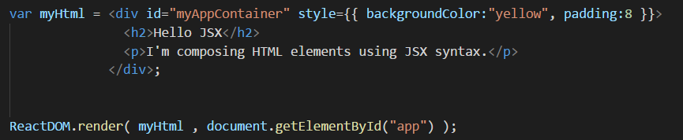
Understanding JSX (and TSX)
JSX provides better syntax for HTML composition
JSX allows extends JavaScript with XML-like syntax
JSX syntax must be transpiled into JavaScript code
JSX/TSX is separate from React library
JSX/TSX commonly used in React development
Babel compiler used to transpile JSX to JavaScript
TypeScript compiler used to transpile TSX to JavaScript

Slide 28
Component Properties and State
Component can contain properties and state
Properties are initialized by external components
Properties are read-only to hosting component
State is set internally by hosting component
Changing state triggers UI refresh by calling render
UI experience created by reacting to changes in state

Slide 29
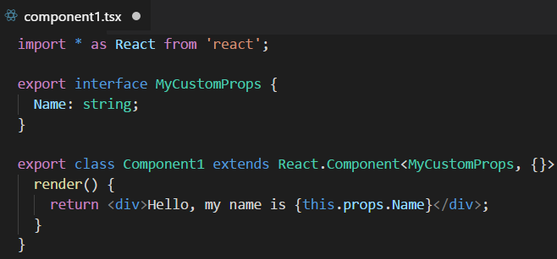
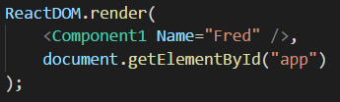
React Component Properties
Defining component with a property
Instantiating component with a property

Slide 30
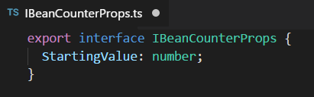
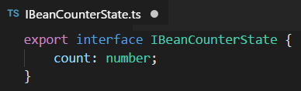
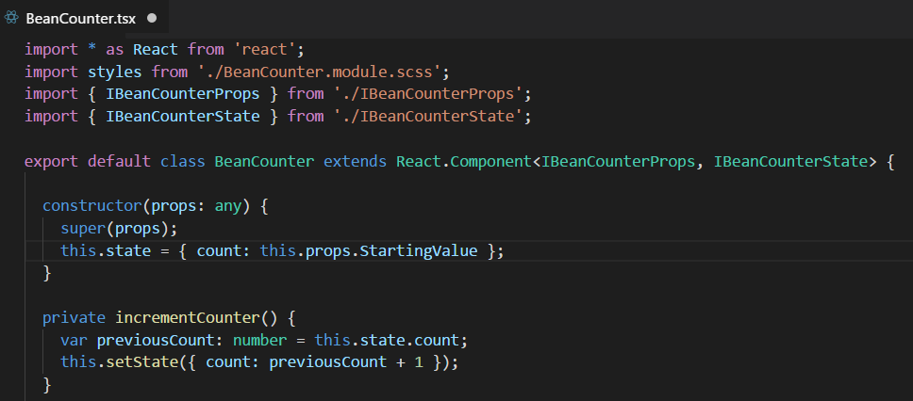
Stateful Component

Slide 31
React Provides Synthetic Events
Replaces standard DOM-based event handling
React creates virtual DOM for elements in component
React interacts with real DOM when required
Provides faster event registration and processing
No need to write browser-specific code

Slide 32
Component Lifecycle
componentWillUpdate
executed before component is rendered
componentDidUpdate
executed after component is rendered
componentWillMount
executed before node is added to the DOM
componentDidMount
executed after node is added to the DOM
componentWillUnmount
executed before node is removed from the DOM
shouldComponentUpdate(newProps, newState)
executed before component is updated

Slide 33
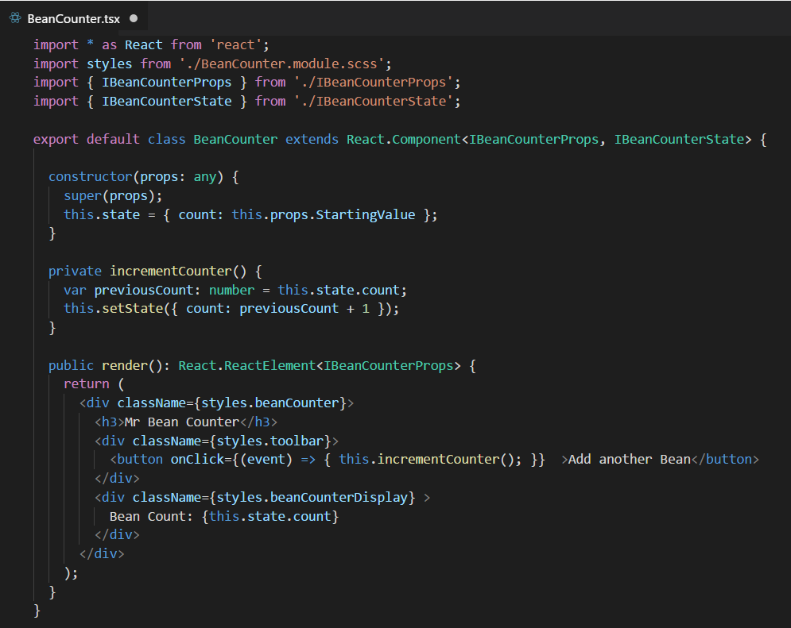
Stateful Component Rendering

Slide 34
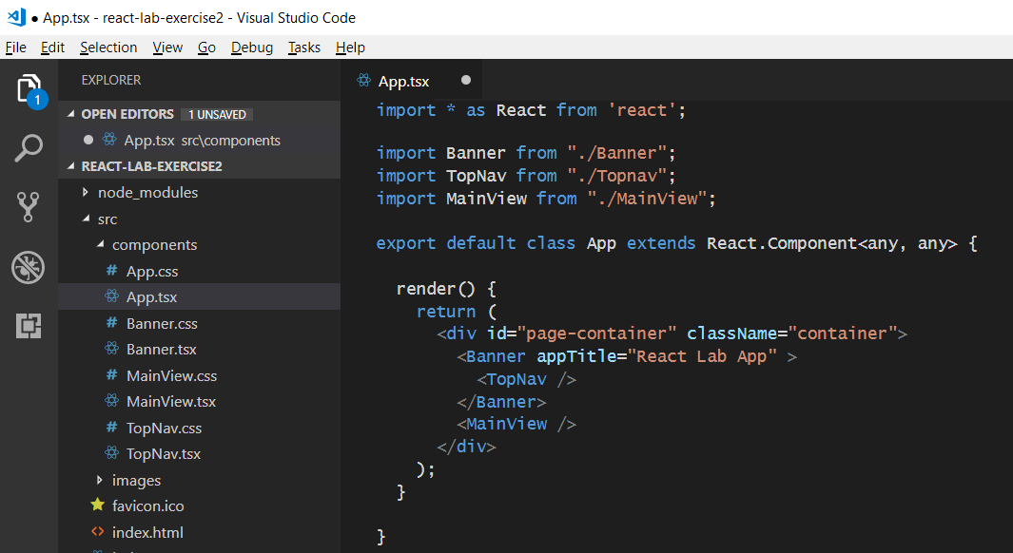
React Component Hierarchies
App
Banner
Topnav
MainView

Slide 35
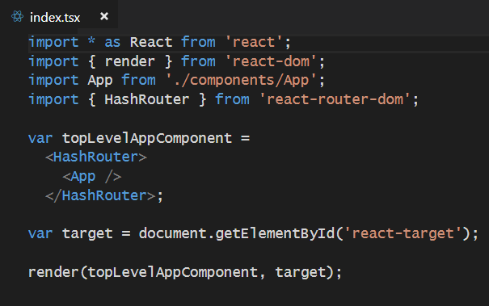
React Router
Used to create route map in single page application (SPA)
Installed as a pair of npm packages
npm install react-router @types/react-router --save-dev
npm install react-router-dom @types/react-router-dom --save-dev
Router must be added in as top-level component above App

Slide 36


Using React Router
Import Route and Switch components
Create route map in HTML output

Slide 37


Creating Route Links

Slide 38



Defining Interfaces for Data Access Code

Slide 39


Calling a Web Service using the Fetch API

Slide 40
Agenda
Developing with Node.js, TypeScript and Webpack
Learning React.js Fundamentals
Using the Office UI Fabric React Component Library
Developing React Webparts with SharePoint Framework
Calling the Microsoft Graph API from React Webparts

Slide 41


What is the Office UI Fabric?
Office UI Fabric is responsive, mobile-first, front-end style framework
Built by Microsoft to style Office 365, OneDrive and SharePoint sites
All about styling instead of JavaScript
Can be used by 3rd party developers
Fabric Core
Fabric React
Fabric JS
ngFabric
Fabric iOS
Core elements of the design language including icons, colors, type, and the grid
Robust, up-to-date components built with the React framework.
Simple, visuals-focused components that you can extend, rework, and build on.
Community-driven project to build components for Angular-based apps.
Native Swift colors, type ramp, and components for building iOS apps.

Slide 42





Fabric Core styling
Fonts and typography
Segoe font family + type ramp
Official Office 365 iconography
Color
Official Office 365 color palette
Branded assets
Product symbols + product filetype symbols
Animations
Official Office 365 selection of easings and animations
Responsive grid
Tailored to Office 365 silhouettes

Slide 43
Styles
The Office UI Fabric provides styles for..
Typography
Color
Icons
Animations
Responsive Grid
Localization

Slide 44

Typography
Base font classes
Fabric includes 10 base font classes
Each base class sets a default size, weight, and color.

Slide 45

Typography
Helper font classes
There are helper font classes to change the text weight.

Slide 46

Color
Includes 9 theme colors and 11 neutral colors.
Helper classes for text, border, background, and hover states.
Color classes act as hooks into the Office 365 theming system

Slide 47

Icons
Fabric uses a custom font for its iconography.
Font contains glyphs you can scale, color, and style

Slide 48

Icons
To use the icons, combine the base ms-Icon class with a modifier class for the specific icon.
<i class="ms-Icon ms-Icon--mail" aria-hidden="true"></i>

Slide 49

Responsive Grid
Fabric comes with a mobile-first, responsive grid
Based on 12 column grid
Used to create flexible layouts
<div class="ms-Grid">
<div class="ms-Grid-row">
<div class="ms-Grid-col ms-u-sm6 ms-u-md4 ms-u-lg2">First</div>
<div class="ms-Grid-col ms-u-sm6 ms-u-md8 ms-u-lg10">Second</div>
</div>
</div>

Slide 50

Office UI Fabric React Components
Fabric's React components are building blocks for UI
Components can be used in general React development
Components can be used in SharePoint Framework development

Slide 51

Office UI Fabric React Component Library
https://developer.microsoft.com/en-us/fabric#/components

Slide 52



Using the DetailsList Component

Slide 53
Agenda
Developing with Node.js, TypeScript and Webpack
Learning React.js Fundamentals
Using the Office UI Fabric React Component Library
Developing React Webparts with SharePoint Framework
Calling the Microsoft Graph API from React Webparts

Slide 54

Creating a React Webpart
You can select React as framework for your webpart
You can create a React webpart when creating new project
You can add React webpart to existing project
React webpart made up of several different source files
React component SCSS module
React component class
React component properties interface
Webpart manifest
Webpart class

Slide 55



React Webpart Architecture
Webpart class instance
React component instance
React.CreateElement
description

Slide 56


React Webpart Styling

Slide 57


Webpart Persistent Properties
Persistent properties defined in webpart using interface
Property default values add to webpart manifest
LeadTrackerWebPart
Webpart instance
persistent
properties

Slide 58




Designing the React Component
LeadTracker
React component

Slide 59

Referencing the React Component Instance
LeadTrackerWebPart
Webpart instance
LeadTracker
React instance
leadTracker

Slide 60



Synchronizing React State with Webpart Properties
Automatic updates
LeadTrackerWebPart
Webpart instance
LeadTracker
React instance
React.Component.setState
targetList

Slide 61
Agenda
Developing with Node.js, TypeScript and Webpack
Learning React.js Fundamentals
Using the Office UI Fabric React Component Library
Developing React Webparts with SharePoint Framework
Calling the Microsoft Graph API from React Webparts

Slide 62
Summary
Developing with Node.js, TypeScript and Webpack
Learning React.js Fundamentals
Using the Office UI Fabric React Component Library
Developing React Webparts with SharePoint Framework
Calling the Microsoft Graph API from React Webparts

Slide 63
Summary
Getting Started with React.js
Creating SPAs using React.js, TypeScript and Webpack
Designing a React Component Hierarchy
Extending a React Project with the React Router
Understanding the React Component Lifecycle Methods
Calling Across the Network using the Fetch API

